Slide 1
Forge VR Explorer
Shawn Cross
Griffin Gonsalves
Paul Kwak

Slide 2
Pitch
Our web application, the Forge VR Explorer, allows anyone and everyone to upload and/or view 3D models. Using Autodesk’s Forge APIs allows you to not just view the model but interact with your models in tons of different ways!
You can easily upload your models with a simple upload button. After uploading, the site will allow you to view that model in Forge’s Large Model Viewer. From there it's just exploring your model.
Of course Autodesk members can directly upload models from their accounts to the site, just login and begin uploading!
One of the biggest purposes of this site is to support concurrency viewing. Using a session allows for multiple people to view and interact with the same model at the same time.

Slide 3
Main Purpose & Goals
Use Vrok.it and the Forge API collection
Increase usability and add slightly more functionality
Upload CAD files
File conversion
Model viewing
VR with Google Cardboard

Slide 4
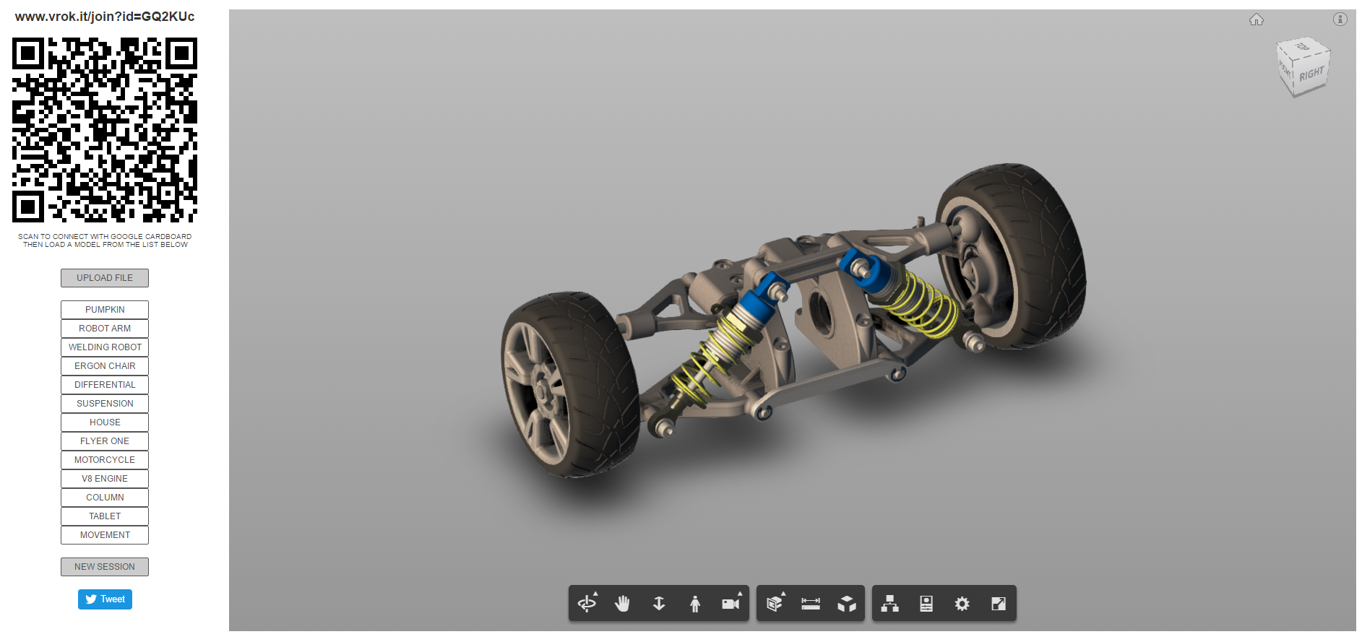

Slide 5
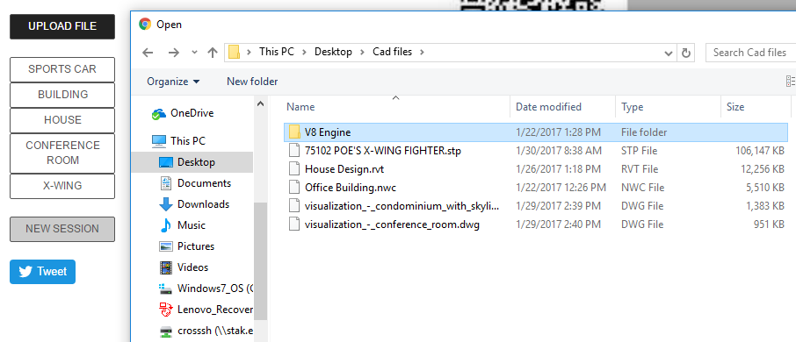
Local File Upload
Model derivative accepts roughly 60 different types of files.
Files Uploaded will be placed in the list of viewable models.
Once successfully uploaded the files will be loaded into the viewer.
Files uploaded will be placed in the
bucket temporally.

Slide 6
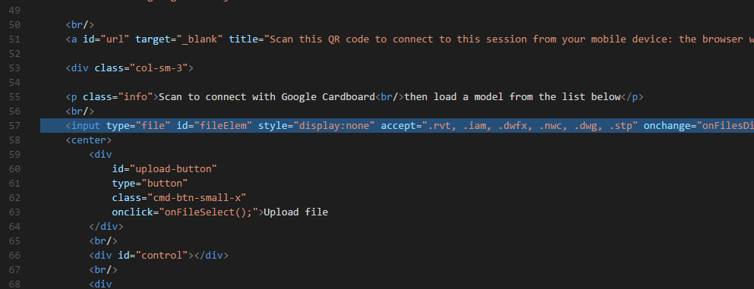
Local File Restriction
Used the html accept attribute to restrict the file types
Only files of the types listed will show up in the file explorer

Slide 7
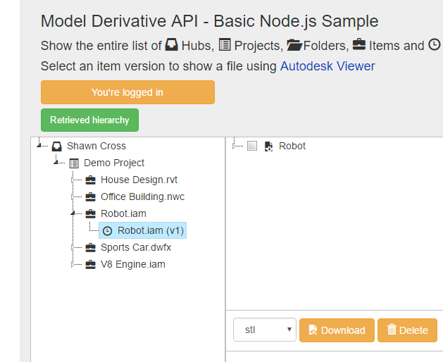
Non Local File Navigation
Displayed in a file tree
User will be able to navigate to any files in their online storage from Autodesk
Selected Files willed be uploaded to the website
Autodesk API being used

Slide 8

Solutions for viewing
Tell viewer not to worry about being reinitialized if nothing has been loaded.
Un-initialize the viewer and set to null.

Slide 9
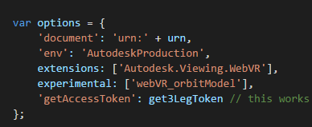
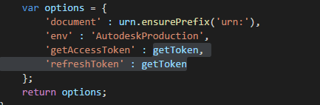
Participant Problem
Need the three-legged token.
Have to pass it to the participant so they can gain access.

Slide 10
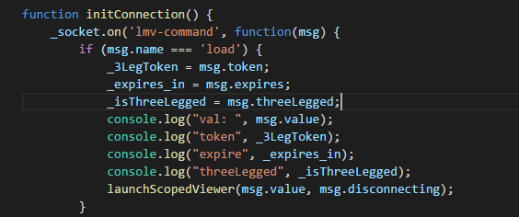
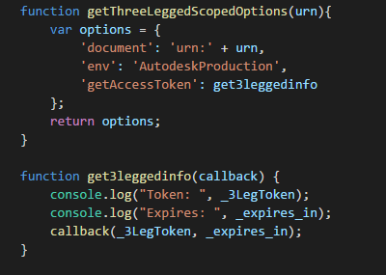
Solution to participant problem
Send the token to the token to the participant via socket.io commands.

Slide 11
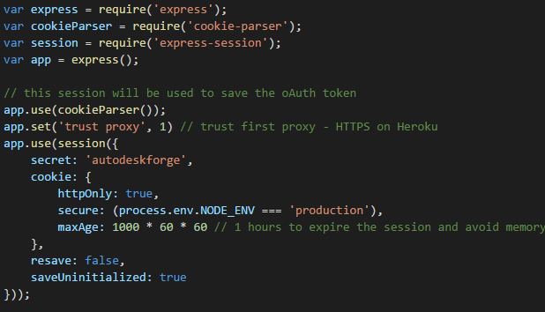
Express.js
Utilized by Vrok.it and API already
Node.js web app framework
Matches on request sent to server

Slide 12
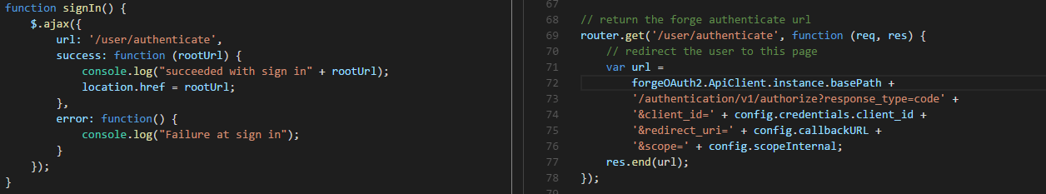
3-Legged Authentication
Url matches and calls function to give url that redirects to Autodesk
Receive URL and redirect to Autodesk to receive token.
Not working as it should…

Slide 13
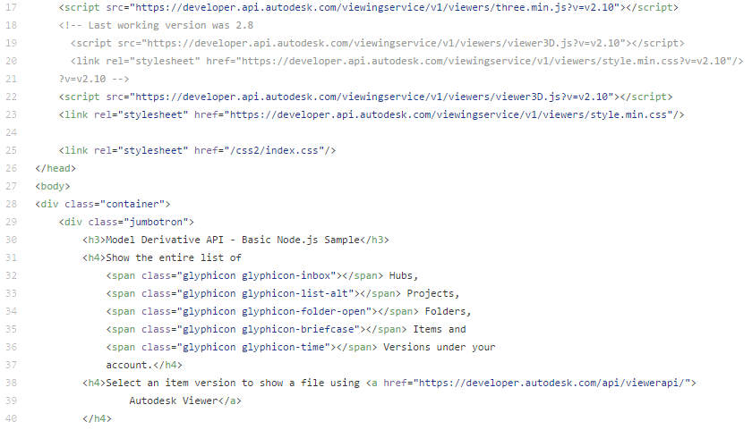
Website Layout
Delays caused challenges
Confusing code
Server backend with Node.js
Multiple CSS files and html index files
Using bootstrap as well
Functioning state
Hope to improve

Slide 14
Forge Explorer
Loading within the page when model selected
Now will open locally uploaded models from bucket
Adjustable set of controls within javascript extension through the API
Plan to enable keyboard controls soon now that models are loading
Stereoscopic views soon to be improved for VR
Updates to viewer

Slide 15
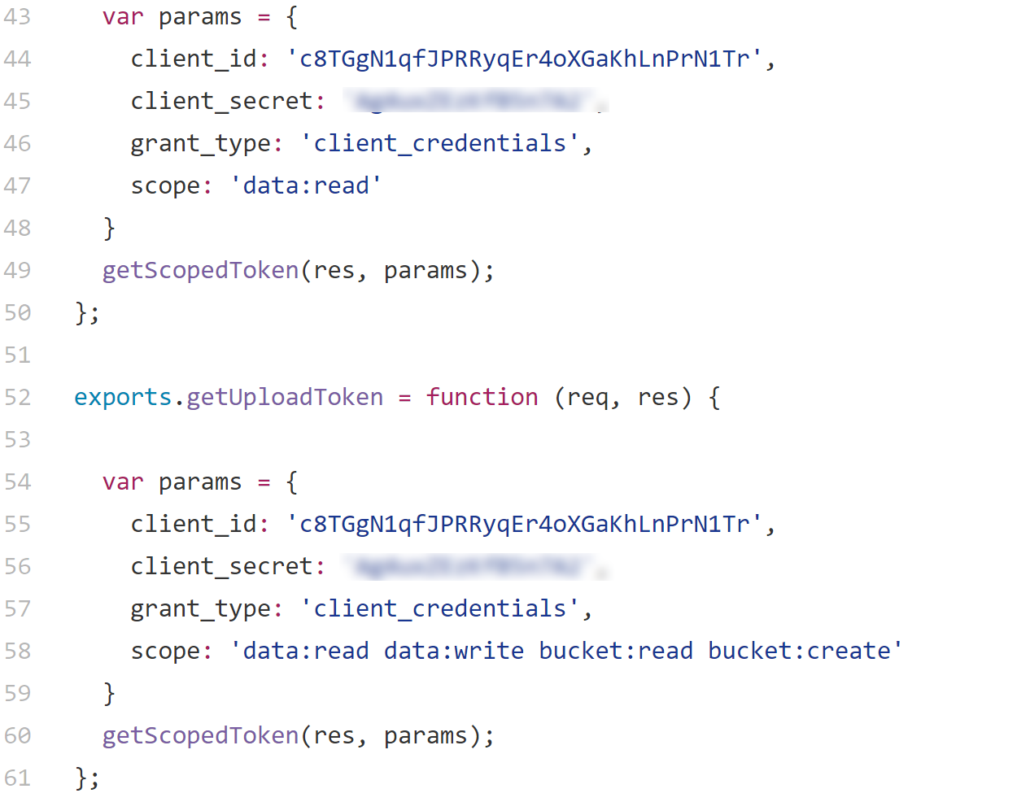
Data Management
Created new bucket
Locks buckets behind authentication
Uses API token stored in session
Conflicting files and errors prevented upload to bucket
Loads models from project buckets

Slide 16
Remaining Tasks
Data Management functionality
Site Usability
Updated UI
Google Cardboard

Slide 17
Week by week summary

Slide 18
Winter Week 1
Began to get the website set up
Planned on using github.io
Layout changes, moving index files

Slide 19
Winter Week 2
Website was more difficult to get setup than we initially thought
switched from using github.io to heroku for server needs
Had to swap out credentials to get site to work properly
Site up and running

Slide 20
Winter Week 3
Troubles setting up file bucket (never used curl before)
Got the bucket setup that will hold the files
Met with Kean and Patti

Slide 21
Winter Week 4
Local file restriction complete
Began working on 3-legged Authentication
Found this would be very hard to do from scratch
Found an API that did exactly what we want
Spoke with Kean about the API we found and decided it would be best to integrate that

Slide 22
Winter Week 5
Began Integration of API
Ran into many problems with the integration
Kean suggested that he could bring in the person that created the API to help

Slide 23
Winter Week 6
Continued to work on integration
Worked on revision for documents to reflect where the project is currently

Slide 24
Winter Week 7
Authorization finally working
Wrong version of node.js was being used
File tree not working still
Some UI changes made

Slide 25
Winter week 8
File tree is finally working
Able to access all file in an A360 account
Selected model still not being displayed in viewer

Slide 26
Winter Week 9
File from A360 are able to be loaded into the viewer now
Ran into problem with participants not being able to see the A360 models

Slide 27
Winter Week 10
Found what was causing the problem for the viewing as a participant
Spoke with Kean and have a good idea of how to fix this problem
Finished the second draft of the poster.

Slide 28
Problem & Solution - Authentication
One of the biggest problems
Scratch code -> adapting existing code
Not understanding code
Contact with code creator

Slide 29
Problems & Solutions - Website
Number of problems adjusting site layout
Mysterious code
Hard to adjust
Communication
Conflicting stylesheets and index files
Hard to debug
Website understood better
More communication with project team

Slide 30
Problems Solutions
Low communication with client
Not enough questions on our side
Not enough time on theirs
Team work
Better planning
Better communication
Faster help seeking
Client
More question asking
Weekly meetings with client?
Team
More planning
Delegation?
Weekly meetings
Seeking help sooner

Slide 31
What’s next?
Continue changes to the UI
Fix the problem with the participant not being able to see the models
Addition of movement to the Forge Viewer
Testing different models

Slide 32
References
https://developer.autodesk.com/
https://github.com/KeanW/vrok-it
https://github.com/Autodesk-Forge/model.derivative-nodejs-sample

